Slide 1
CS 2009 Design and Analysis of Algorithms
Waheed Ahmed
Email : waheedahmed@nu.edu.pk

Slide 2
Week 3:
Algorithms Runtime, Insertion Sort, Merge Sort

Slide 3
INSERTION SORT
Algorithm, Proof of Correctness, Runtime

Slide 4
THE SORTING TASK
INPUT: a list of n elements (assume all elements are distinct)
3
2
6
8
1
5
4
7
1
2
3
4
5
6
7
8
OUTPUT: a list with those n elements in sorted order!

Slide 5
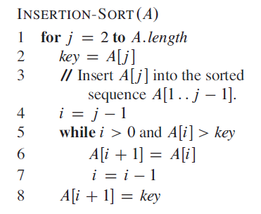
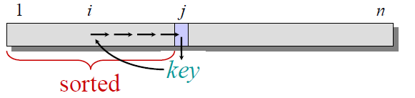
INSERTION SORT: PSEUDOCODE
InsertionSort(A):
for j in range(1, len(A)):
key = A[j]
// insert A[j] into sorted A[1.. j-1].
i = j – 1
while i >= 0 and A[i] > key:
A[i+1] = A[i]
i -= 1
A[i+1] = key
Same Algorithm with different Syntax

Slide 6
INSERTION SORT: EXAMPLE
Intuition: Maintain a growing sorted list. For each element, put it into its “correct” place in this growing list.
3
2
5
1
4
InsertionSort(A):
for j in range(1, len(A)):
key = A[j]
// insert A[j] into sorted A[1.. j-1].
i = j – 1
while i >= 0 and A[i] > key:
A[i+1] = A[i]
i -= 1
A[i+1] = key

Slide 7
INSERTION SORT: EXAMPLE
Intuition: Maintain a growing sorted list. For each element, put it into its “correct” place in this growing list.
3
2
5
1
4
At the start, our growing sorted list only has one element (the first element):
3 is in its “correct” place within the growing list (shaded)
InsertionSort(A):
for j in range(1, len(A)):
key = A[j]
// insert A[j] into sorted A[1.. j-1].
i = j – 1
while i >= 0 and A[i] > key:
A[i+1] = A[i]
i -= 1
A[i+1] = key
Notes:
Shift one place

Slide 8
INSERTION SORT: EXAMPLE
Intuition: Maintain a growing sorted list. For each element, put it into its “correct” place in this growing list.
3
2
5
1
4
Now we look at A[1] = 2. We’ll move 2 into its “correct” place in the growing sorted list.
InsertionSort(A):
for j in range(1, len(A)):
key = A[j]
// insert A[j] into sorted A[1.. j-1].
i = j – 1
while i >= 0 and A[i] > key:
A[i+1] = A[i]
i -= 1
A[i+1] = key

Slide 9
INSERTION SORT: EXAMPLE
Intuition: Maintain a growing sorted list. For each element, put it into its “correct” place in this growing list.
2
3
5
1
4
Now we look at A[1] = 2. We’ll move 2 into its “correct” place in the growing sorted list.
Now we look at A[1] = 2. We’ll move 2 into its “correct” place in the growing sorted list.
In other words, move 2 towards the start of the list until it hits something smaller (or if it can’t go any further).
InsertionSort(A):
for j in range(1, len(A)):
key = A[j]
// insert A[j] into sorted A[1.. j-1].
i = j – 1
while i >= 0 and A[i] > key:
A[i+1] = A[i]
i -= 1
A[i+1] = key

Slide 10
INSERTION SORT: EXAMPLE
Intuition: Maintain a growing sorted list. For each element, put it into its “correct” place in this growing list.
2
3
5
1
4
Now we look at A[2] = 5. We’ll move 5 into its “correct” place in the growing sorted list.
InsertionSort(A):
for j in range(1, len(A)):
key = A[j]
// insert A[j] into sorted A[1.. j-1].
i = j – 1
while i >= 0 and A[i] > key:
A[i+1] = A[i]
i -= 1
A[i+1] = key

Slide 11
INSERTION SORT: EXAMPLE
Intuition: Maintain a growing sorted list. For each element, put it into its “correct” place in this growing list.
2
3
5
1
4
Now we look at A[2] = 5. We’ll move 5 into its “correct” place in the growing sorted list.
It’s already where it should be in the growing sorted list, so we don’t need to move it anywhere. Moving on!
InsertionSort(A):
for j in range(1, len(A)):
key = A[j]
// insert A[j] into sorted A[1.. j-1].
i = j – 1
while i >= 0 and A[i] > key:
A[i+1] = A[i]
i -= 1
A[i+1] = key

Slide 12
INSERTION SORT: EXAMPLE
Intuition: Maintain a growing sorted list. For each element, put it into its “correct” place in this growing list.
2
3
5
1
4
Now we look at A[3] = 1. We’ll move 1 into its “correct” place in the growing sorted list.
InsertionSort(A):
for j in range(1, len(A)):
key = A[j]
// insert A[j] into sorted A[1.. j-1].
i = j – 1
while i >= 0 and A[i] > key:
A[i+1] = A[i]
i -= 1
A[i+1] = key

Slide 13
INSERTION SORT: EXAMPLE
Intuition: Maintain a growing sorted list. For each element, put it into its “correct” place in this growing list.
1
2
3
5
4
Now we look at A[3] = 1. We’ll move 1 into its “correct” place in the growing sorted list.
We move it all the way to the front, since that’s its “correct” position in this growing sorted list.
InsertionSort(A):
for j in range(1, len(A)):
key = A[j]
// insert A[j] into sorted A[1.. j-1].
i = j – 1
while i >= 0 and A[i] > key:
A[i+1] = A[i]
i -= 1
A[i+1] = key

Slide 14
INSERTION SORT: EXAMPLE
Intuition: Maintain a growing sorted list. For each element, put it into its “correct” place in this growing list.
1
2
3
5
4
Finally, we look at A[4] = 4. We’ll move 4 into its “correct” place in the growing sorted list.
InsertionSort(A):
for j in range(1, len(A)):
key = A[j]
// insert A[j] into sorted A[1.. j-1].
i = j – 1
while i >= 0 and A[i] > key:
A[i+1] = A[i]
i -= 1
A[i+1] = key

Slide 15
INSERTION SORT: EXAMPLE
Intuition: Maintain a growing sorted list. For each element, put it into its “correct” place in this growing list.
1
2
3
4
5
Finally, we look at A[4] = 4. We’ll move 4 into its “correct” place in the growing sorted list.
It just needs to squeeze in right before 5.
InsertionSort(A):
for j in range(1, len(A)):
key = A[j]
// insert A[j] into sorted A[1.. j-1].
i = j – 1
while i >= 0 and A[i] > key:
A[i+1] = A[i]
i -= 1
A[i+1] = key

Slide 16
INSERTION SORT: EXAMPLE
Intuition: Maintain a growing sorted list. For each element, put it into its “correct” place in this growing list.
1
2
3
4
5
And, that’s it! We’ve finished performing Insertion Sort on this example array of five elements.
Now we ask… does it work?
InsertionSort(A):
for j in range(1, len(A)):
key = A[j]
// insert A[j] into sorted A[1.. j-1].
i = j – 1
while i >= 0 and A[i] > key:
A[i+1] = A[i]
i -= 1
A[i+1] = key

Slide 17
INSERTION SORT: EXAMPLE FOR YOU
Intuition: Maintain a growing sorted list. For each element, put it into its “correct” place in this growing list.
8
2
4
9
3
6
InsertionSort(A):
for j in range(1, len(A)):
key = A[j]
// insert A[j] into sorted A[1.. j-1].
i = j – 1
while i >= 0 and A[i] > key:
A[i+1] = A[i]
i -= 1
A[i+1] = key

Slide 18
INSERTION SORT: DOES IT WORK?
Since the algorithm isn’t too complex, it might feel pretty obvious… but it won’t be so obvious later, so let’s take some time now to see how to prove the correctness of this algorithm rigorously..
3
2
5
1
4
We verified Insertion Sort worked for this particular input list.
However, we need to prove that the algorithm works for all possible input lists.

Slide 19
INSERTION SORT: DOES IT WORK?
Since the algorithm isn’t too complex, it might feel pretty obvious… but it won’t be so obvious later, so let’s take some time now to see how to prove the correctness of this algorithm rigorously..
3
2
5
1
4
We verified Insertion Sort worked for this particular input list.
However, we need to prove that the algorithm works for all possible input lists.
HERE’S WHAT WE FOCUS ON:
Insertion Sort is an iterative algorithm - what does each iteration promise?

Slide 20
INSERTION SORT: DOES IT WORK?
HERE’S WHAT WE FOCUS ON:
Each iteration of the algorithm promises to add one more element to the sorted region.
In other words: by the end of iteration i, we’re guaranteed that the first j+1 elements in the array are sorted.

Slide 21
INSERTION SORT: DOES IT WORK?
HERE’S WHAT WE FOCUS ON:
Each iteration of the algorithm promises to add one more element to the sorted region.
In other words: by the end of iteration i, we’re guaranteed that the first j+1 elements in the array are sorted.
THIS IS A JOB FOR: PROOF BY Loop Invariant!

Slide 22
3 INGREDIENTS OF LOOP INVARIANT
INITIALIZATION
It is true prior to the first iteration of the loop.

Slide 23
3 INGREDIENTS OF LOOP INVARIANT
INITIALIZATION
It is true prior to the first iteration of the loop.
MAINTENANCE
If it is true before an iteration of the loop, it remains true before the next iteration.

Slide 24
3 INGREDIENTS OF LOOP INVARIANT
INITIALIZATION
It is true prior to the first iteration of the loop.
MAINTENANCE
If it is true before an iteration of the loop, it remains true before the next iteration.
TERMINATION
When the loop terminates, the invariant gives us a useful property that helps show that the algorithm is correct.

Slide 25
3 INGREDIENTS OF LOOP INVARIANT
Best Case
(In Mathematical Induction terms)
INITIALIZATION
It is true prior to the first iteration of the loop.
Inductive Step
(In Mathematical Induction terms)
MAINTENANCE
If it is true before an iteration of the loop, it remains true before the next iteration.
TERMINATION
When the loop terminates, the invariant gives us a useful property that helps show that the algorithm is correct.

Slide 26
PROOF BY LOOP INVARIANT
INITIALIZATION
Before iteration 1 of the outer loop (i.e. start of algorithm) when j = 1, the list A[:1] is sorted (only 1 element), which shows that the loop invariant holds prior to the first iteration of the loop.

Slide 27
PROOF BY LOOP INVARIANT
INITIALIZATION
Before iteration 1 of the outer loop (i.e. start of algorithm) when j = 1, the list A[:1] is sorted (only 1 element), which shows that the loop invariant holds prior to the first iteration of the loop.
MAINTENANCE
Informally, the body of the for loop works by moving A[j- 1], A[j - 2], A[j-3], and so on by one position to the right until it finds the proper position for A[j], at which point it inserts the value of A[j]. The subarray A[1..j] then consists of the elements originally in A[1..j] but in sorted order. Incrementing j for the next iteration of the for loop then preserves the loop invariant.
Notes:
Maintenance: Next, we tackle the second property: showing that each iteration maintains the loop invariant.

Slide 28
PROOF BY LOOP INVARIANT
INITIALIZATION
Before iteration 1 of the outer loop (i.e. start of algorithm) when j = 1, the list A[:1] is sorted (only 1 element), which shows that the loop invariant holds prior to the first iteration of the loop.
MAINTENANCE
Informally, the body of the for loop works by moving A[j- 1], A[j - 2], A[j-3], and so on by one position to the right until it finds the proper position for A[j], at which point it inserts the value of A[j]. The subarray A[1..j] then consists of the elements originally in A[1..j] but in sorted order. Incrementing j for the next iteration of the for loop then preserves the loop invariant.
TERMINATION
Because each loop iteration increases j by 1, we must have j = n + 1. Replace n + 1 for j in the loop invariant. we have that the subarray A[1..n] consists of the elements originally in A[1..n] but in sorted order
Notes:
Maintenance: Next, we tackle the second property: showing that each iteration maintains the loop invariant.

Slide 29
INSERTION SORT: IS IT FAST?
At most n outer for-loop iterations

Slide 30
INSERTION SORT: IS IT FAST?
At most n outer for-loop iterations
At most n inner while-loop iterations

Slide 31
INSERTION SORT: IS IT FAST?
At most n outer for-loop iterations
At most n inner while-loop iterations
We have ~n for-loop iterations. Each iteration does O(n) work. (Each for-loop iteration performs an inner-while loop which iterates up to n times and does O(1) work in each iteration).

Slide 32
INSERTION SORT: IS IT FAST?
At most n outer for-loop iterations
At most n inner while-loop iterations
OVERALL RUNTIME OF INSERTION SORT: O(n²)

Slide 33
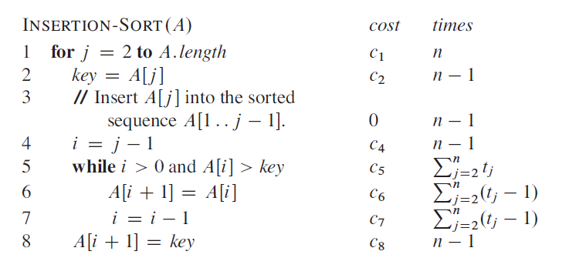
INSERTION SORT: IS IT FAST?

Slide 34
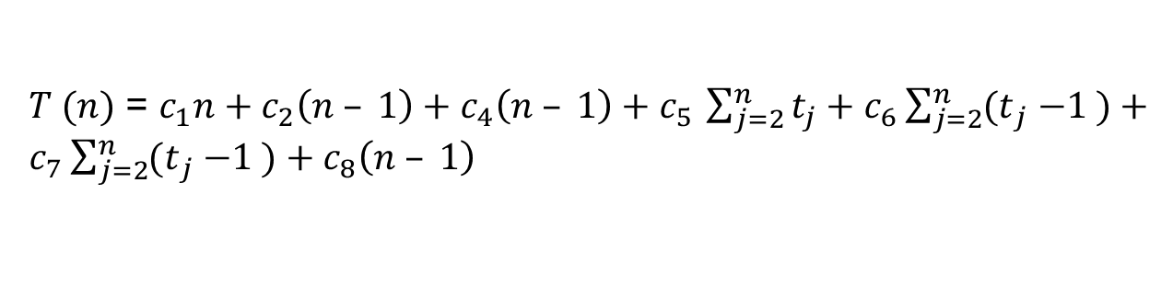
INSERTION SORT: (Complexity)

Slide 35
INSERTION SORT: (Complexity)
Best Case (Sorted Array)
BEST CASE RUNTIME OF INSERTION SORT: O(n)

Slide 36





INSERTION SORT: (Complexity)
Arithmetic Series (The Summation)

Slide 37
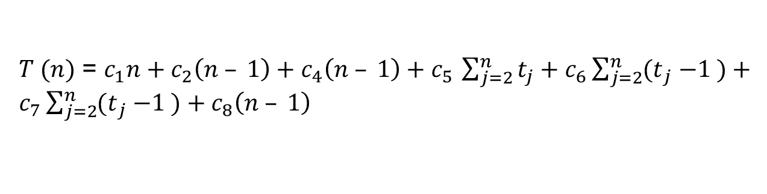
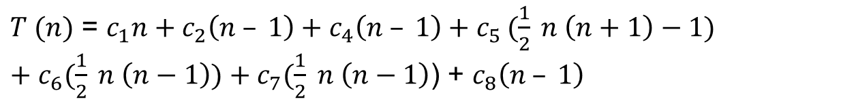
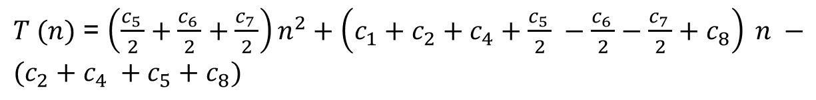
INSERTION SORT: (Complexity)
OVERALL RUNTIME OF INSERTION SORT: O(n²)

Slide 38
INSERTION SORT: IS IT FAST?
THE QUESTION IS...
CAN WE DO BETTER?
OVERALL RUNTIME OF INSERTION SORT: O(n²)

Slide 39
MERGESORT
Algorithm, Proof of Correctness, Runtime

Slide 40
MERGESORT
DIVIDE-AND-CONQUER: an algorithm design paradigm
break up a problem into smaller subproblems
solve those subproblems recursively
combine the results of those subproblems to get the overall answer
big problem
sub- problem
sub- problem
sub-sub problem
sub-sub problem
sub-sub problem
sub-sub problem

Slide 41
MERGESORT
3
2
6
8
1
5
4
7

Slide 42
MERGESORT
3
2
6
8
1
5
4
7
Divide original list in half
3
2
6
8
1
5
4
7

Slide 43
MERGESORT
3
2
6
8
1
5
4
7
Divide original list in half
3
2
6
8
1
5
4
7
Recursive magic
Recursive magic
Recursively sort each half
2
3
6
8
1
4
5
7

Slide 44
MERGESORT
3
2
6
8
1
5
4
7
Divide original list in half
3
2
6
8
1
5
4
7
Recursive magic
Recursive magic
Recursively sort each half
2
3
6
8
1
4
5
7
Cleverly “Merge” sorted halves

Slide 45
MERGESORT
3
2
6
8
1
5
4
7
Divide original list in half
3
2
6
8
1
5
4
7
Recursive magic
Recursive magic
Recursively sort each half
2
3
6
8
1
4
5
7
Cleverly “Merge” sorted halves
1

Slide 46
MERGESORT
3
2
6
8
1
5
4
7
Divide original list in half
3
2
6
8
1
5
4
7
Recursive magic
Recursive magic
Recursively sort each half
2
3
6
8
1
4
5
7
Cleverly “Merge” sorted halves
1
2

Slide 47
MERGESORT
3
2
6
8
1
5
4
7
Divide original list in half
3
2
6
8
1
5
4
7
Recursive magic
Recursive magic
Recursively sort each half
2
3
6
8
1
4
5
7
Cleverly “Merge” sorted halves
1
2
3

Slide 48
MERGESORT
3
2
6
8
1
5
4
7
Divide original list in half
3
2
6
8
1
5
4
7
Recursive magic
Recursive magic
Recursively sort each half
2
3
6
8
1
4
5
7
Cleverly “Merge” sorted halves
1
2
3
4

Slide 49
MERGESORT
3
2
6
8
1
5
4
7
Divide original list in half
3
2
6
8
1
5
4
7
Recursive magic
Recursive magic
Recursively sort each half
2
3
6
8
1
4
5
7
Cleverly “Merge” sorted halves
1
2
3
4
5

Slide 50
MERGESORT
3
2
6
8
1
5
4
7
Divide original list in half
3
2
6
8
1
5
4
7
Recursive magic
Recursive magic
Recursively sort each half
2
3
6
8
1
4
5
7
Cleverly “Merge” sorted halves
1
2
3
4
5
6

Slide 51
MERGESORT
3
2
6
8
1
5
4
7
Divide original list in half
3
2
6
8
1
5
4
7
Recursive magic
Recursive magic
Recursively sort each half
2
3
6
8
1
4
5
7
Cleverly “Merge” sorted halves
1
2
3
4
5
6
7

Slide 52
MERGESORT
3
2
6
8
1
5
4
7
Divide original list in half
3
2
6
8
1
5
4
7
Recursive magic
Recursive magic
Recursively sort each half
2
3
6
8
1
4
5
7
Cleverly “Merge” sorted halves
1
2
3
4
5
6
7
8

Slide 53
MERGESORT: PSEUDOCODE
Intuition: Divide and Conquer. If you sort your left and right halves, it’s easier to “Merge” them into a sorted list.
MERGESORT(A):
n = len(A)
if n <= 1:
return A

Slide 54
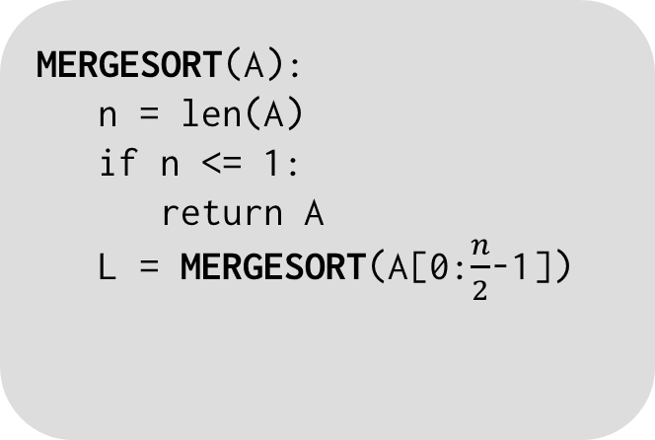
MERGESORT: PSEUDOCODE
Intuition: Divide and Conquer. If you sort your left and right halves, it’s easier to “Merge” them into a sorted list.
MERGESORT(A):
n = len(A)
if n <= 1:
return A
L = MERGESORT(A[0:$\frac{n}{2}$-1])

Slide 55
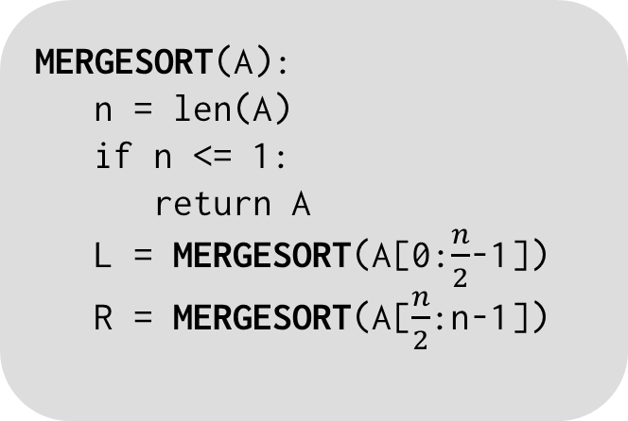
MERGESORT: PSEUDOCODE
Intuition: Divide and Conquer. If you sort your left and right halves, it’s easier to “Merge” them into a sorted list.
MERGESORT(A):
n = len(A)
if n <= 1:
return A
L = MERGESORT(A[0:$\frac{n}{2}$-1])
R = MERGESORT(A[$\frac{n}{2}$:n-1])

Slide 56
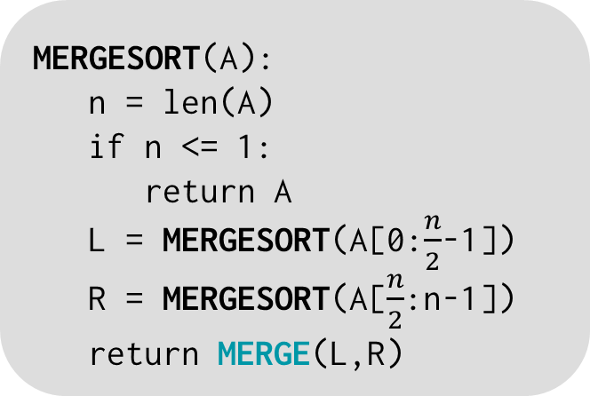
MERGESORT: PSEUDOCODE
Intuition: Divide and Conquer. If you sort your left and right halves, it’s easier to “Merge” them into a sorted list.
MERGESORT(A):
n = len(A)
if n <= 1:
return A
L = MERGESORT(A[0:$\frac{n}{2}$-1])
R = MERGESORT(A[$\frac{n}{2}$:n-1])
return MERGE(L,R)

Slide 57

MERGESORT: PSEUDOCODE
Intuition: Divide and Conquer. If you sort your left and right halves, it’s easier to “Merge” them into a sorted list.
MERGESORT(A):
n = len(A)
if n <= 1:
return A
L = MERGESORT(A[0:$\frac{n}{2}$-1])
R = MERGESORT(A[$\frac{n}{2}$:n-1])
return MERGE(L,R)
MERGE(L,R):
result = length n array
L[n/2] = ∞; R[n] = ∞
i = 0, j = 0
for k in [0,...,n-1]:
if L[i] < R[j]:
result[k] = L[i]
i += 1
else:
result[k] = R[j]
j += 1
return result

Slide 58
MERGESORT: RECURSIVE CALLS
3
2
6
8
1
5
4
7

Slide 59
MERGESORT: RECURSIVE CALLS
3
2
6
8
1
5
4
7
Recurse!
Recurse!
3
2
6
8
1
5
4
7

Slide 60
MERGESORT: RECURSIVE CALLS
3
2
6
8
1
5
4
7
Recurse!
Recurse!
3
2
6
8
1
5
4
7
Recurse!
Recurse!
Recurse!
Recurse!
3
2
6
8
1
5
4
7

Slide 61
MERGESORT: RECURSIVE CALLS
3
2
6
8
1
5
4
7
Recurse!
Recurse!
3
2
6
8
1
5
4
7
Recurse!
Recurse!
Recurse!
Recurse!
3
2
6
8
1
5
4
7
Recurse!
Recurse!
Recurse!
Recurse!
This is where we hit our base case!
3
2
6
8
1
5
4
7

Slide 62
MERGESORT: MERGE STEPS
3
2
6
8
1
5
4
7

Slide 63
MERGESORT: MERGE STEPS
2
3
6
8
1
5
4
7
MERGE!
MERGE!
MERGE!
MERGE!
3
2
6
8
1
5
4
7

Slide 64
MERGESORT: MERGE STEPS
2
3
6
8
1
4
5
7
MERGE!
MERGE!
MERGE!
MERGE!
2
3
6
8
1
5
4
7
MERGE!
MERGE!
MERGE!
MERGE!
3
2
6
8
1
5
4
7

Slide 65
MERGESORT: MERGE STEPS
1
2
3
4
5
6
7
8
We have a sorted sequence!
MERGE!
MERGE!
2
3
6
8
1
4
5
7
MERGE!
MERGE!
MERGE!
MERGE!
2
3
6
8
1
5
4
7
MERGE!
MERGE!
MERGE!
MERGE!
3
2
6
8
1
5
4
7

Slide 66
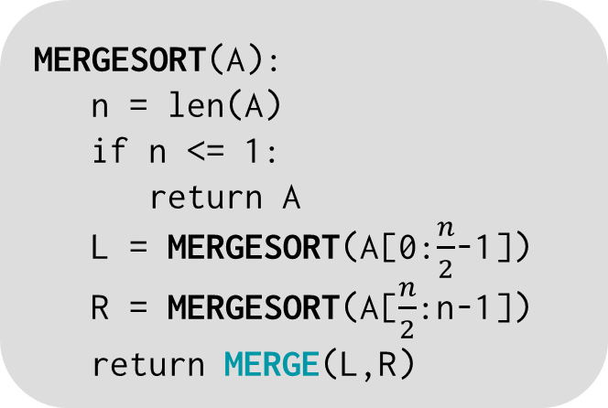
MERGESORT: IS IT FAST?
MERGESORT(A):
n = len(A)
if n <= 1:
return A
L = MERGESORT(A[0:$\frac{n}{2}$-1])
R = MERGESORT(A[$\frac{n}{2}$:n-1])
return MERGE(L,R)
CLAIM: MergeSort runs in time O(n log n)

Slide 67
AN ASIDE: O(n log n) vs. O(n²)?
log(n) grows very slowly! (Much more slowly than n)
log(2) = 1
log(4) = 2
…
log(64) = 6
log (128) = 7
…
log(4096) = 12
…
log(# particles in the universe) < 280
ALL LOGARITHMS IN THIS COURSE ARE BASE 2

Slide 68
AN ASIDE: O(n log n) vs. O(n²)?
log(n) grows very slowly! (Much more slowly than n)
log(2) = 1
log(4) = 2
…
log(64) = 6
log (128) = 7
…
log(4096) = 12
…
log(# particles in the universe) < 280
ALL LOGARITHMS IN THIS COURSE ARE BASE 2
n log n grows much more slowly than n²
Punchline: A running time of O(n log n) is a LOT better than O(n²)
Notes:
3.28 x 10⁸⁰

Slide 69
MERGESORT RECURSION TREE
Level | # of Problems | Size of each Problem | Work done per Problem ≤ | Total work on this level
0
1
…
t
…
log₂n
n
n/2
n/2
· · ·
n/2^{t}
n/2^{t}
· · ·
n/2^{t}
n/2^{t}
· · ·
1
1
1
1
· · ·
1
1
1
1

Slide 70
MERGESORT RECURSION TREE
Level | # of Problems | Size of each Problem | Work done per Problem ≤ | Total work on this level
0 | 1 | n
1 | 2¹ | n/2
…
t | 2^{t} | n/2^{t}
…
log₂n | 2^{log2 n} = n | 1
n
n/2
n/2
· · ·
n/2^{t}
n/2^{t}
· · ·
n/2^{t}
n/2^{t}
· · ·
1
1
1
1
· · ·
1
1
1
1

Slide 71
MERGESORT RECURSION TREE
If a subproblem is of size n, then the work done in that subproblem is O(n).
⇒ Work ≤ c · n (c is a constant)
Level | # of Problems | Size of each Problem | Work done per Problem ≤ | Total work on this level
0 | 1 | n | c · n
1 | 2¹ | n/2 | c · (n/2)
…
t | 2^{t} | n/2^{t} | c · (n/2^{t})
…
log₂n | 2^{log2 n} = n | 1 | c · (1)
n
n/2
n/2
· · ·
n/2^{t}
n/2^{t}
· · ·
n/2^{t}
n/2^{t}
· · ·
1
1
1
1
· · ·
1
1
1
1

Slide 72
MERGESORT RECURSION TREE
If a subproblem is of size n, then the work done in that subproblem is O(n).
⇒ Work ≤ c · n (c is a constant)
Level | # of Problems | Size of each Problem | Work done per Problem ≤ | Total work on this level
0 | 1 | n | c · n | O(n)
1 | 2¹ | n/2 | c · (n/2) | 2¹ · c ·(n/2) = O(n)
…
t | 2^{t} | n/2^{t} | c · (n/2^{t}) | 2^{t} · c ·(n/2^{t}) = O(n)
…
log₂n | 2^{log2 n} = n | 1 | c · (1) | n · c ·(1) = O(n)
n
n/2
n/2
· · ·
n/2^{t}
n/2^{t}
· · ·
n/2^{t}
n/2^{t}
· · ·
1
1
1
1
· · ·
1
1
1
1

Slide 73
MERGESORT RECURSION TREE
Level | # of Problems | Size of each Problem | Work done per Problem ≤ | Total work on this level
0 | 1 | n | c · n | O(n)
1 | 2¹ | n/2 | c · (n/2) | 2¹ · c ·(n/2) = O(n)
…
t | 2^{t} | n/2^{t} | c · (n/2^{t}) | 2^{t} · c ·(n/2^{t}) = O(n)
…
log₂n | 2^{log2 n} = n | 1 | c · (1) | n · c ·(1) = O(n)
If a subproblem is of size n, then the work done in that subproblem is O(n).
⇒ Work ≤ c · n (c is a constant)
n
n/2
n/2
· · ·
n/2^{t}
n/2^{t}
· · ·
n/2^{t}
n/2^{t}
· · ·
1
1
1
1
· · ·
1
1
1
1
We have (log₂n + 1) levels, each level has O(n) work total ⇒ O(n log n) work overall!

Slide 74
MERGESORT: O(n log n) RUNTIME
Using the “Recursion Tree Method” (i.e. drawing the tree & filling out the table), we showed that the runtime of MergeSort is O(n log n)
Level | # of Problems | Size of each Problem | Work done per Problem ≤ | Total work on this level
0 | 1 | n | c · n | O(n)
1 | 2¹ | n/2 | c · (n/2) | 2¹ · c ·(n/2) = O(n)
…
t | 2^{t} | n/2^{t} | c · (n/2^{t}) | 2^{t} · c ·(n/2^{t}) = O(n)
…
log₂n | 2^{log2 n} = n | 1 | c · (1) | n · c ·(1) = O(n)
n
n/2
n/2
· · ·
n/2^{t}
n/2^{t}
· · ·
n/2^{t}
n/2^{t}
· · ·
1
1
1
1
· · ·
1
1
1
1

Slide 75
MERGESORT Loop Invariant & Recurrence Relations

Slide 76
MERGE-SORT Running Time
Divide:
compute q as the average of p and r: D(n) = Θ(1)
Conquer:
recursively solve 2 subproblems, each of size n/2 ⇒ 2T (n/2)
Combine:
MERGE on an n-element subarray takes Θ(n) time ⇒ C(n) = Θ(n)
Θ(1) if n =1
T(n) = 2T(n/2) + Θ(n) if n > 1

Slide 77
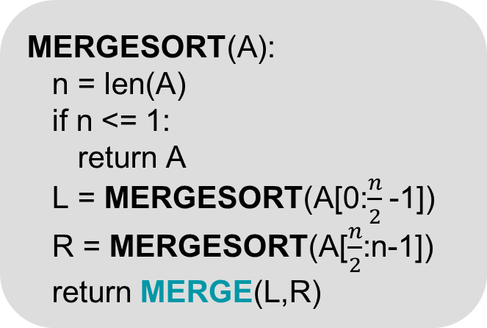
MERGESORT: PSEUDOCODE
Intuition: Divide and Conquer. If you sort your left and right halves, it’s easier to “Merge” them into a sorted list.
MERGESORT(A):
n = len(A)
if n <= 1:
return A
L = MERGESORT(A[0:$\frac{n}{2}$ -1])
R = MERGESORT(A[$\frac{n}{2}$:n-1])
return MERGE(L,R)
MERGE(L,R):
n = len(L) + len(R)
result = empty array of size n
L[n/2] = ∞; R[n] = ∞
i = 0, j = 0
for k in [0,...,n-1]:
if L[i] < R[j]:
result[k] = L[i]
i += 1
else:
result[k] = R[j]
j += 1
return result

Slide 78
3 INGREDIENTS OF LOOP INVARIANT
INITIALIZATION
It is true prior to the first iteration of the loop.
MAINTENANCE
If it is true before an iteration of the loop, it remains true before the next iteration.
TERMINATION
When the loop terminates, the invariant gives us a useful property that helps show that the algorithm is correct.

Slide 79
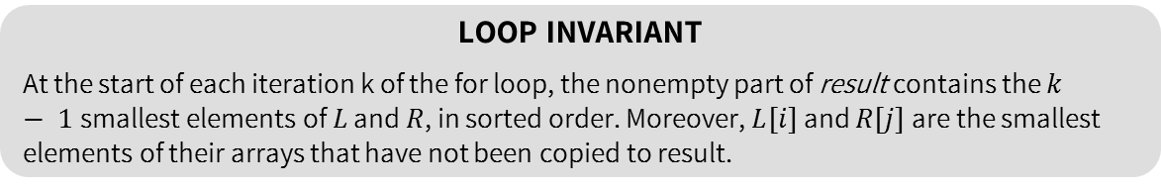
PROOF BY LOOP INVARIANT
The loop invariant we will use for merge sort problem is
LOOP INVARIANT
At the start of each iteration k of the for loop, the nonempty part of result contains the $k − 1$smallest elements of $L$ and $R$, in sorted order. Moreover, $L[i]$ and $R[j]$are the smallest elements of their arrays that have not been copied to result.
INITIALIZATION
The loop invariant holds prior to the first iteration of the loop. Here, i = 0, j = 0, and result array is completely empty. L[0] is the smallest element of L, while R[0] is the smallest element of R, so the initialization step holds.
Notes:
Merge is correct.

Slide 80
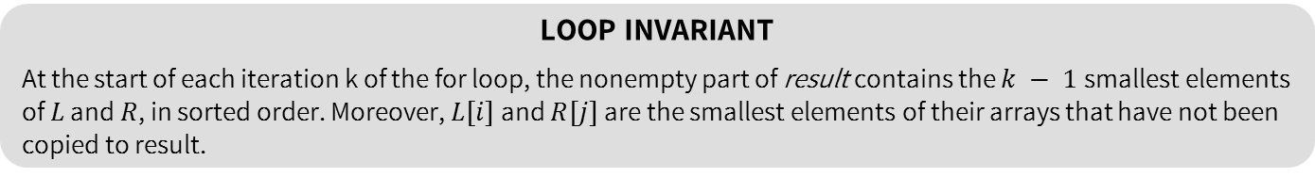
PROOF BY LOOP INVARIANT
LOOP INVARIANT
At the start of each iteration k of the for loop, the nonempty part of result contains the $k − 1$smallest elements of $L$ and $R$, in sorted order. Moreover, $L[i]$ and $R[j]$are the smallest elements of their arrays that have not been copied to result.
INITIALIZATION
The loop invariant holds prior to the first iteration of the loop. Here, i = 0, j = 0, and result array is completely empty. L[0] is the smallest element of L, while R[0] is the smallest element of R, so the initialization step holds.
MAINTENANCE
To see that each iteration maintains the loop invariant, suppose that L[i] ≤ R[j]. Then L[i] is the smallest element not yet copied to result array. The current nonempty part of result consists of the k − 1 smallest elements, so after the loop is over and L[i] is copied to result, the nonempty part of result will consist of the k smallest elements. Incrementing k (in the for loop update) and i reestablishes the loop invariant for the next iteration.

Slide 81
PROOF BY LOOP INVARIANT
INITIALIZATION
The loop invariant holds prior to the first iteration of the loop. Here, i = 0, j = 0, and result array is completely empty. L[0] is the smallest element of L, while R[0] is the smallest element of R, so the initialization step holds.
MAINTENANCE
To see that each iteration maintains the loop invariant, suppose that L[i] ≤ R[j]. Then L[i] is the smallest element not yet copied to result array. The current nonempty part of result consists of the k − 1 smallest elements, so after the loop is over and L[i] is copied to result, the nonempty part of result will consist of the k smallest elements. Incrementing k (in the for loop update) and i reestablishes the loop invariant for the next iteration.
TERMINATION
At termination, k = n. By the loop invariant, result array contains the n smallest elements of L and R, in sorted order. This is the result that we wanted (i.e. the merging of the two sorted arrays to produce a new sorted array).

